Slide 1
OE2E04 – INTRODUCTION TO DEEP LEARNING MENTOR: DR. AMIT VISHWAKARMA
Problem Statement
Multisensory and Deep Learning
Based Real-Time Dense Forest
Monitoring System
TEAM MEMBERS
Ojas Kasana
Aditya Kumar
24BCS178
24BCS016
Deepak Kumar
Masabathini Saketh
24BSM018
24BCS147
Muntazir Ali
24BCS148

Slide 2
Project Overview
Two deep learning models developed to detect and monitor environmental threats from remote sensing data
Model 1: Deforestation Detector
Model 2: Wildfire Classifier
Semantic segmentation of Sentinel-2 satellite imagery
Multi-band input: B04, B08, B11, B12 (Red, NIR, SWIR)
Temporal change detection: 2025 vs 2026 imagery
ResNet-based encoder with custom decoder head
Pixel-wise forest / deforested classification
Binary image classification: fire vs. no-fire
Input: aerial / satellite RGB imagery patches
MobileNetV2 fine-tuned (TensorFlow/Keras)
Tested on forest_fire validation dataset
Fast inference for real-time alerting

Slide 3
Model 1: Deforestation Detection
Sentinel-2 Multispectral Imagery · Pixel-wise Segmentation · Temporal Change Analysis
Sentinel-2
Input Bands
Patch
Extraction
128×128
U-Net
Encoder
U-Net
Decoder
Sigmoid
Output
Mask
Input Bands
Patch Size
Temporal Pair
B04 (Red), B08 (NIR),
B11, B12 (SWIR)
128 × 128 pixels x 4
Feb 2025 vs. 2026
Sentinel-2 tile T44RKU (Uttarakhand)
Training Strategy
Architecture
Loss Function
Balanced 50/50 patches
Forest vs. Deforested
UNet encoder +
custom segmentation head
BCE + Dice Loss
with class weighting

Slide 4
Deforestation Model: Results
Quantitative metrics and sample predictions on held-out validation tiles
86.83%
62.65%
71.06%
66.59%
49.92%
Accuracy
Precision
Recall
F1 Score
IoU Score
Confusion Matrix
Key Insights
 | Pred: Forest | Pred: Deforest
Act: Forest | 966,179 ✓ | 102,517
Act: Deforest | 70,043 | 171,981 ✓
High accuracy (86.8%) driven by dominant forest class
IoU of 49.9% indicates moderate segmentation quality — typical for challenging change detection tasks
Recall (71%) > Precision (62.6%): model favors detecting deforestation over avoiding false alarms
Optimal threshold tuned to 0.35 to maximize IoU
Class imbalance challenges remain; balanced patch strategy partially addressed this

Slide 5
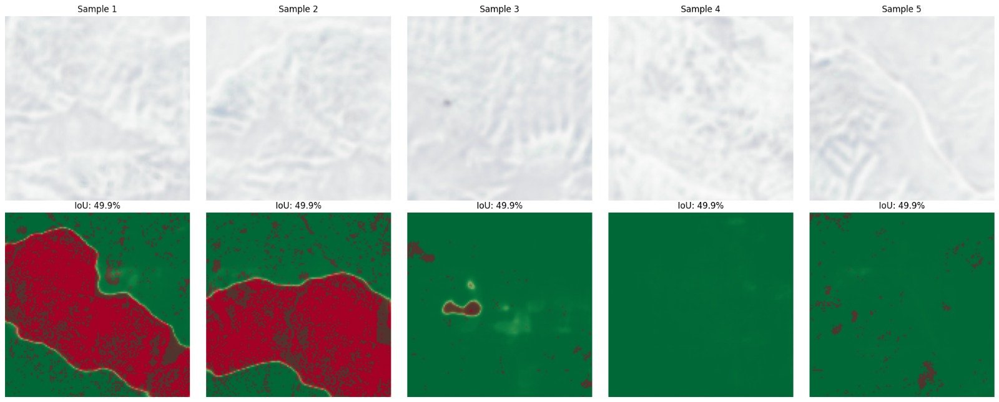
Prediction Visualization
Sample segmentation outputs — Red = Deforested · Green = Forest · IoU: 49.9% per tile

